Slide 1

Big Data Project
“Scalable Processing of Dominance-Based Queries”
Konstantinos Giantsios
Vasiliki Lavrentiadou

Slide 2
Overview
Contents:
Datasets(1 slide)
Skyline algorithm, results and system resources( 3-4 slides)
Top-k Dominating points algorithm, results and system resources (4 slices)
Task 3 algorithm, results and system resources ( 3 slides)
Feature work (1 slide )

Slide 3

Distribution System
Spark version 3.4.7
Scala version 2.11.12

Slide 4
Datasets
Correlated and Uniform developed with Scala
Normal and Anticorrelated developed with Python
2, 3 and 4 dimensional datasets generated
Correlated and Anticorrelated datasets generated with Cholesky transformation
10.000, 50.000, 100.000, 500.000, 1.000.000 and 10.000.000 data points
10.000.000 data points were used on 2-dimensions only for the skyline computation due to increased tardiness

Slide 5
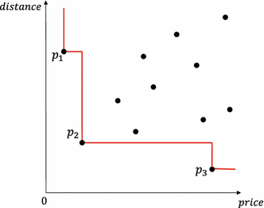
Dominance and Skyline
A point p(1,5) is a Skyline point when it’s not dominated by any other point
A point p(1,5) dominates another point q(2,6) when 2>1 and 6>5
A point l(1,7) has 1=1 and 7>5 therefore is dominated by p

Slide 6
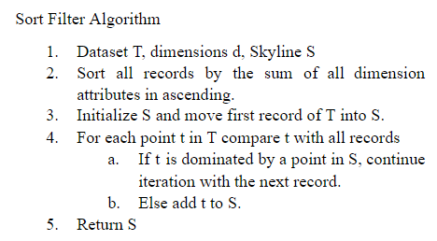
Skyline
System Resources
AMD Ryzen 5, 6 cores, 12 logical processors
8GB Memory
Algorithm
Examined Sort Filter and R-tree
Utilized Sort Filter
Parameters
2 cores
6 cores
Skyline Spark computation
Local Skyline on each partition
Global Skyline on driver

Slide 7
Skyline Spark
The dataset loaded in rdd and distributed in partitions Number of partitions same as number of cores
Global Skyline
In each partition :
The Sort filter algorithm is applied
Tuples of data (according to their dimension) created
ex. (x,y,z,id,sum(x,v,z))
sort by sum (TupleN)
A list (local skyline) created in each partition
1st point (of sorted rdd ) inserted to skyline
Each point compared to points in skyline list until it gets dominated (stops comparison) or not dominated at all (added to skyline)
Local skyline lists are returned to the driver where the SFS is additionally applied for the computation of global Skyline
Local Skyline
...
Local Skyline
...
Local Skyline

Slide 8
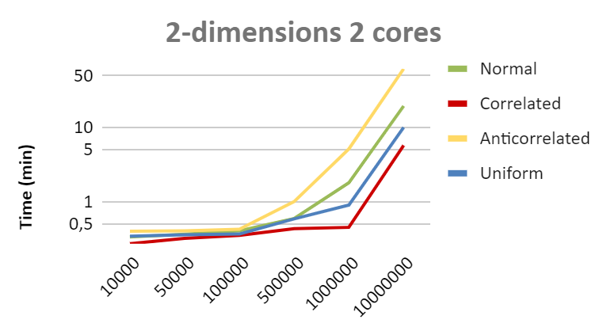
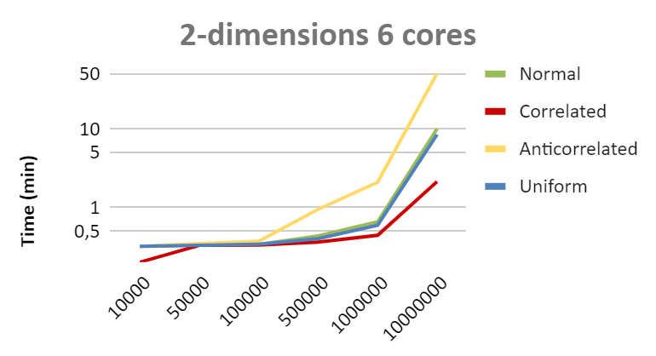
Skyline 2-d

Slide 9
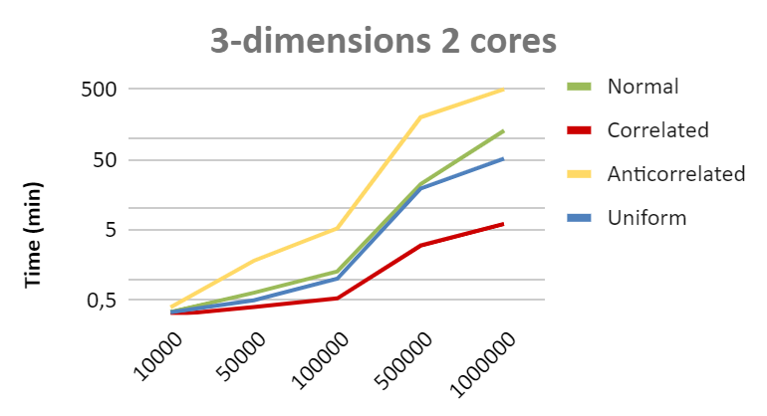
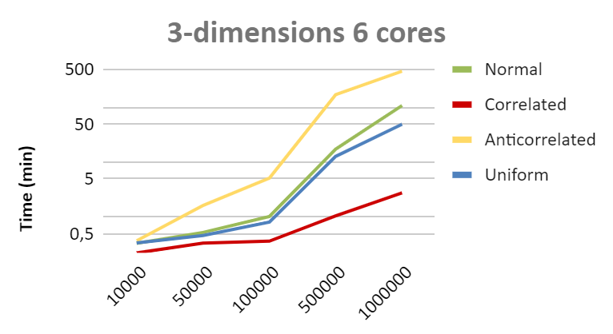
Skyline 3d

Slide 10
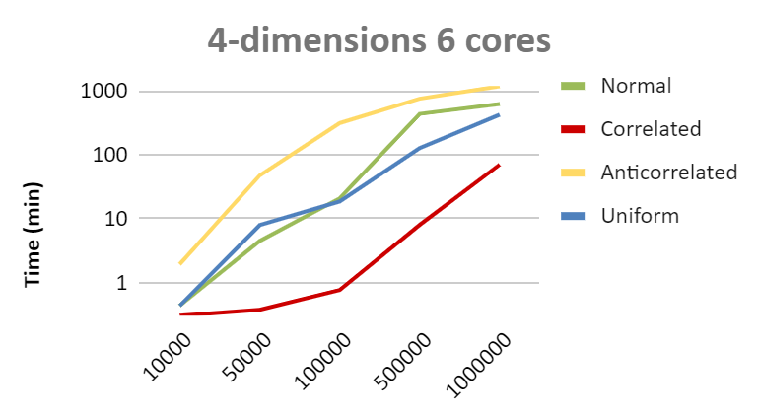
Skyline 4-dimensions

Slide 11
Skyline Conclusions
Anticorrelated distribution is the most computationally expensive
Fewer cores perform poor as the volume of data increases
The algorithm is based on dimension comparisons, therefore more dimensions equal longer execution times
Correlated data have the lowest runtimes

Slide 12
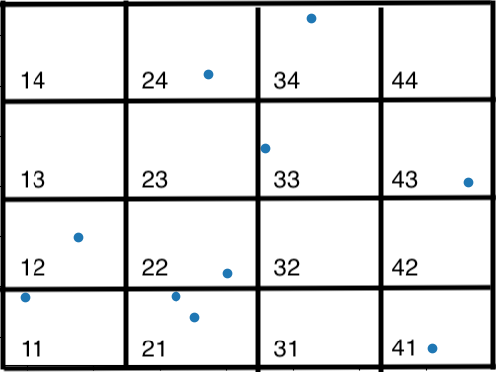
Top-k Dominating points
Axiom 1. Given a grid cell g, its upper bound score ru(g) is the total point count of cells it partially or fully dominates.
e.g. the grid cell 22 in figure has 1 partially dominated point and 3 fully dominated points so its upper bound score is 4.
Axiom 2. Given a grid cell g, its lower bound score rl(g) is the total point count of cells it fully dominates.
e.g. the grid cell 22 in figure has a lower bound score equal to 3.
Axiom 3. Given a grid cell g, g.f is its total point count of cells fully dominating g.
e.g. for cell 33 its g.f is equal to 5.
Axiom 4. Cells with zero count and cells with g.f < k are not accounted as cells that we must check (e.g. 33).
Axiom 5. The prune score of a grid ps is defined as the lowest upper score of remaining grid cells. Those cells that have a lower bound score than the prune score can be pruned.

Slide 13
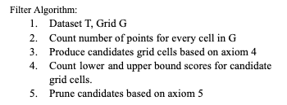
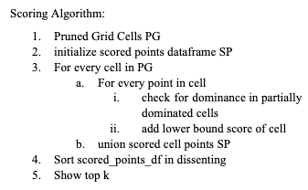
Top-k Dominating points algorithms

Slide 14
Top-k Dominating points algorithms
FILTER ALGORITHM SPARK USAGE
SCORING ALGORITHM SPARK USAGE
Filter
Count
CELL
Filter
SQL JOIN
& GROUPBY
SCORED CELL
Distributed Dataframe
filter
Count
PARTIALLY DOMINATED POINTS
UNION
SP
Distributed Dataframe
filter
Count

Slide 15
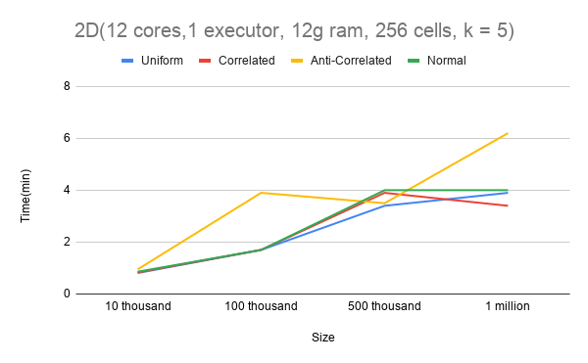
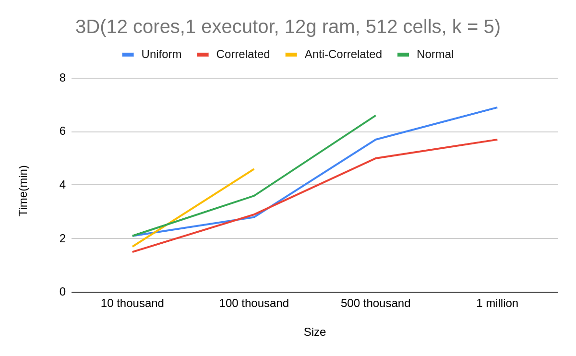
Top-k Dominating points experiments
Time fluctuation changing dataset size
experiment
System Resources
AMD Ryzen 5, 6 cores, 12 logical processors
16GB Memory
Manjaro 20.2.1
Standalone Spark

Slide 16
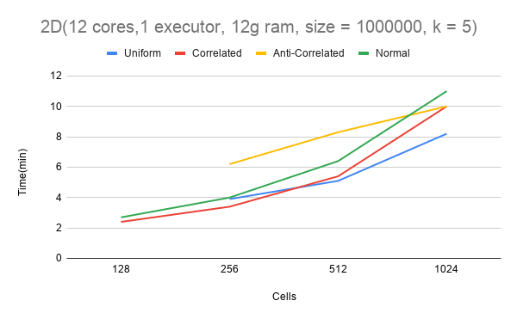
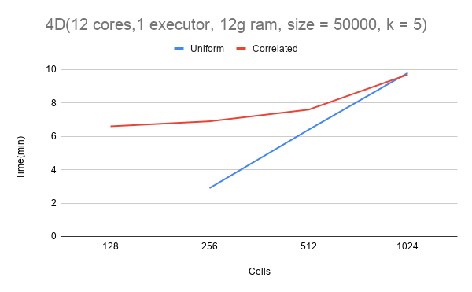
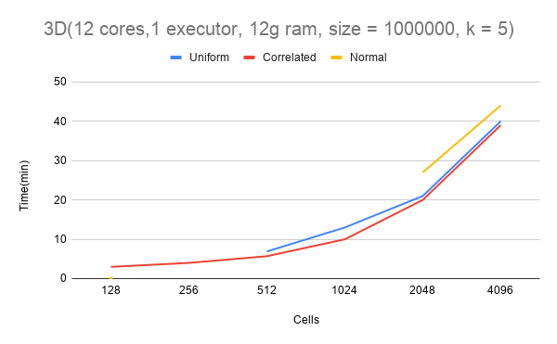
Top-k Dominating points experiments
Cells fine tuning experiment

Slide 17
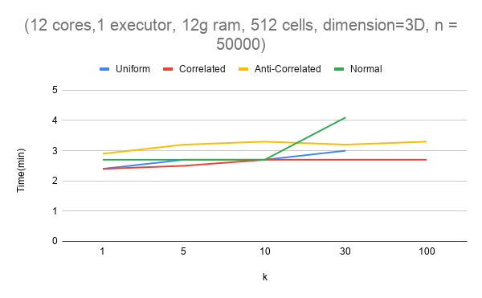
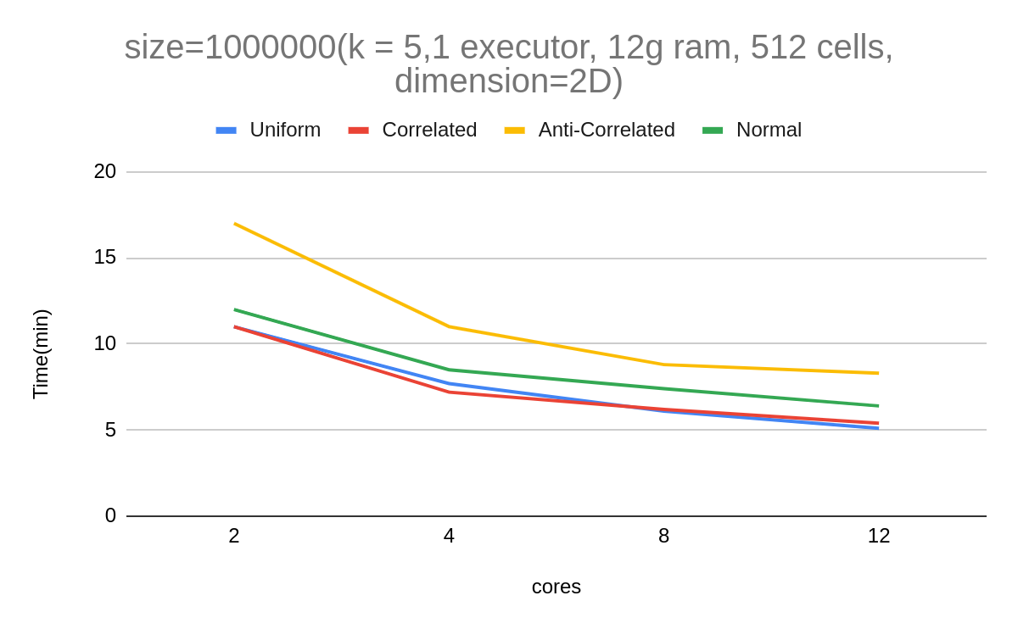
Top-k Dominating points experiments
Time fluctuation changing k experiment
Time fluctuation changing cores experiment

Slide 18
Top-k Dominating points experiments
Conclusion
Algorithm has a hard time when is applied on Anti-Correlated and some times on Normal distributions
More cells doesn’t mean better performance
Grid cells fine tuning is required as dimensions are increasing.
Algorithms takes advantage the extra cores.

Slide 19
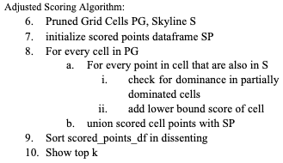
Top-k Dominating Skyline points algorithm
Axiom 6. Given a grid cell g, g.fs is its total point count of cells fully dominating g and are part of the skyline.
Axiom 7. (Adjusted axiom 4). Cells with zero count, with zero skyline points and cells with g.fs < k are not accounted as cells that we must check.
The Filter algorithm stays the same but only on the third step the candidates are produced based on axiom 7.

Slide 20
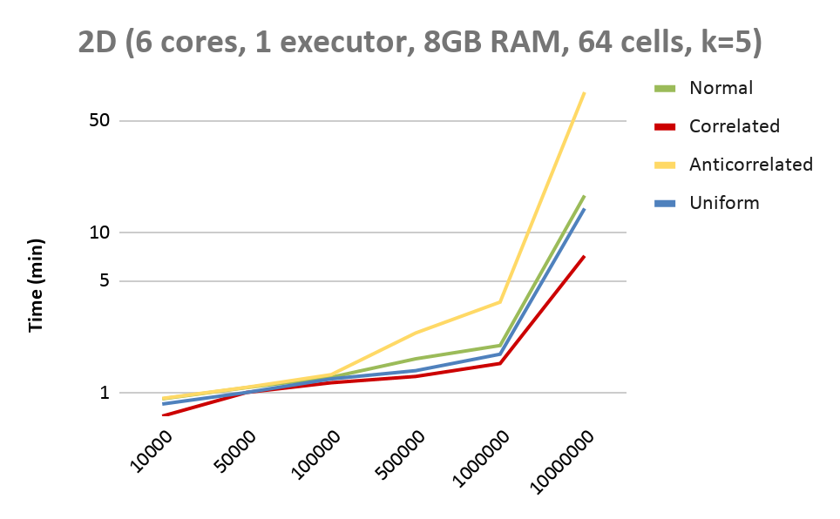
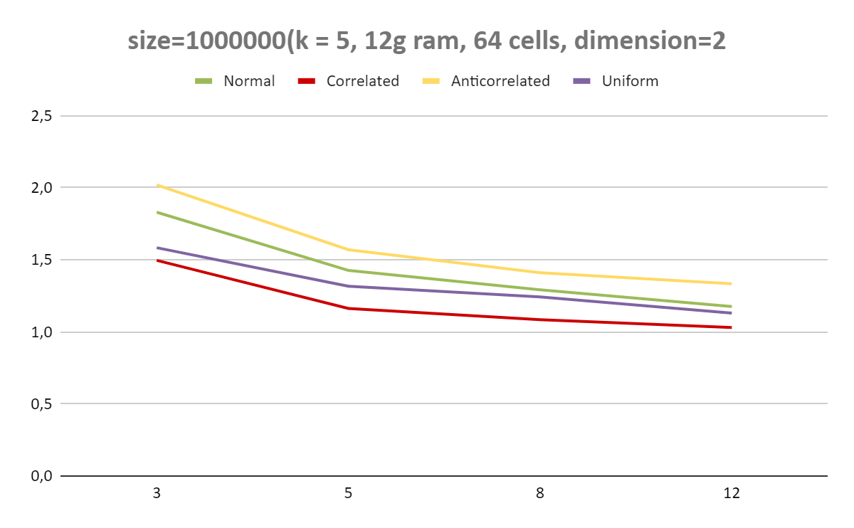
Top-k Dominating Skyline points experiments

Slide 21
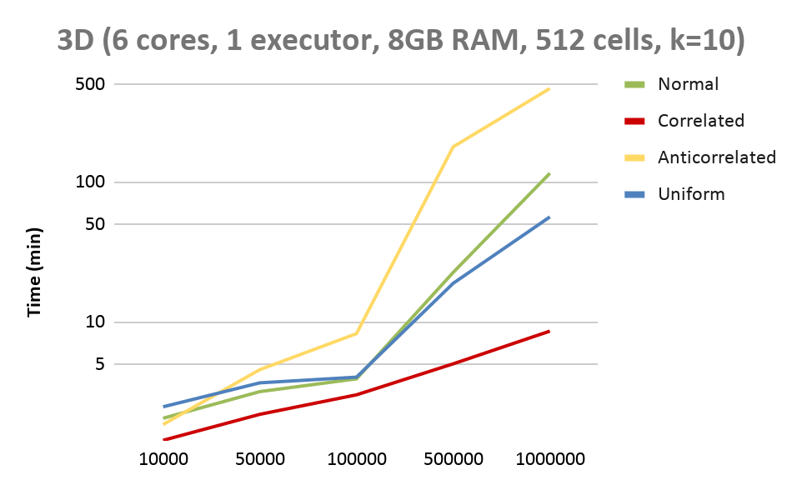
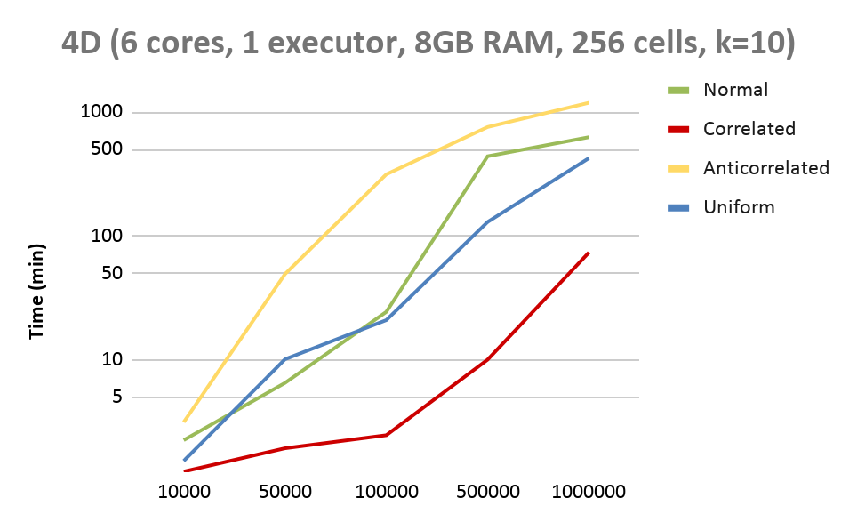
Top-k Dominating Skyline points experiments

Slide 22
Overall Conclusions
Anti-Correlated distribution is the costliest of all
The code runtime is affected by the number of cores participating in the execution
If the code was executed on cluster of computers , the execution times would have been reduced
The execution of Skyline and Top-k dominance scores on local machines isn’t representative
Data isn't Big enough to be considered Big Data and a single machine seeks to perform the function of several parallel machines
Code developed is useful to understand the parallel function of Spark, and the results offer insight on the capabilities that it provides

Slide 23
Big Data Project
“Scalable Processing of Dominance-Based Queries”
Konstantinos Giantsios
Vasiliki Lavrentiadou

